Slide 1
Fertilizers Recommendation System For Disease Prediction
IBM PROJECT
Team Members:
SRIRAM SB [TL]
LOGESH SANJAY R
MANIKANDAN N
VENUGOPAL B
FACULTY MENTOR:
SWATHI D
ASSISTANT PROFESSOR
DEPARTMENT OF CSE

Slide 2
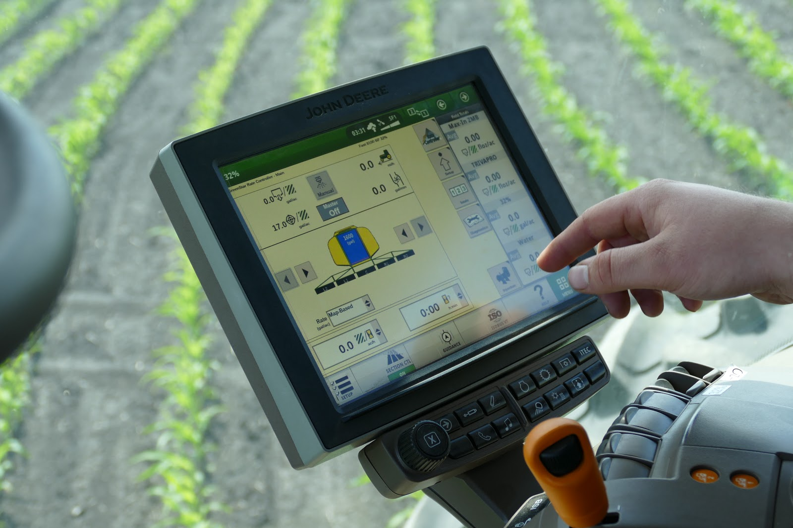
ABSTRACT
Agriculture is the art and science of cultivating the soil, growing crops and raising livestock.
Agriculture provides most of the world’s food and fabrics. Cotton, wool, and leather are all agricultural products.Agriculture also provides wood for construction and paper products.

Slide 3
EXISTING PROBLEM
Irrigation decreases reliance on the monsoon, increases food security, and boosts agricultural production.
Most research articles use humidity, moisture, and temperature sensors near the plant's root, with an external device handling all of the data provided by the sensors and transmitting it directly to an external display or an Android application.
The application was created to measure the approximate values of temperature, humidity and moisture sensors that were programmed into a microcontroller to manage the amount of water.
The cause of fertilizer price fluctuations is related to the supply and demand factors. India also faces a handicap due to lack of natural resources required to produce fertilizers.

Slide 4
PROPOSED SOLUTION
And then we have to create Web Application where:
Farmers can easily interact with the application that we have built.
Detection and recognition of plant diseases using machine learning are very efficient in providing symptoms of identifying diseases at its earliest.
Our web application analysis the disease of the crop or leaf and suggests the farmer with the fertilizers are to be used.
This web application makes the farmers to take right decision in selecting the fertilizer for crop disease such that agricultural sector will be developed by innovative idea.

Slide 5
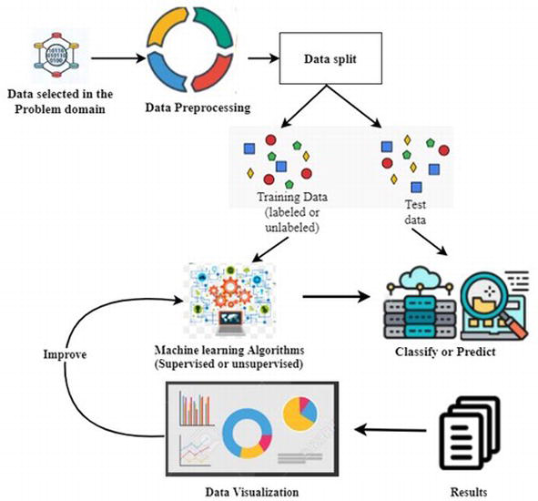
TECHNICAL ARCHITECTURE

Slide 6
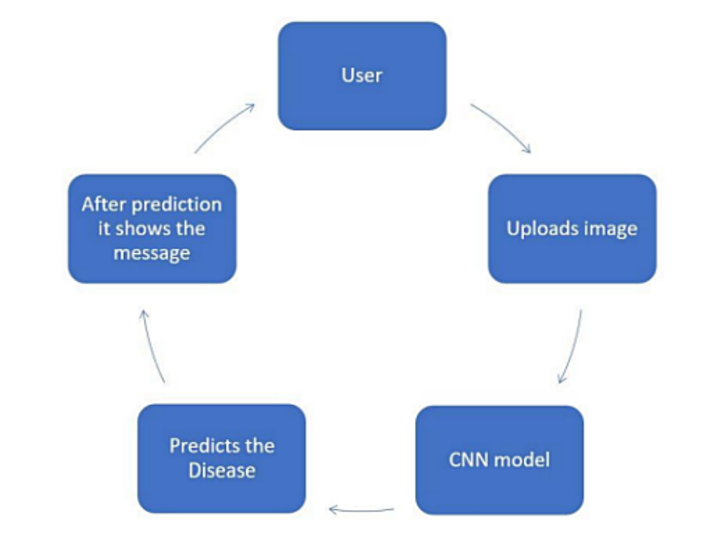
FLOW CHART

Slide 7
HARDWARE & SOFTWARE REQUIREMENT
To complete this project, you should have the following software and packages.
Software’s:
➢ Anaconda Navigator
➢ py charm
➢ Visual studio code
➢ Jupiter notebook
➢ IBM Watson studio
Packages:
➢ Tensor flow
➢ Keras
➢ Flask
➢ numpy
Pandas

Slide 8
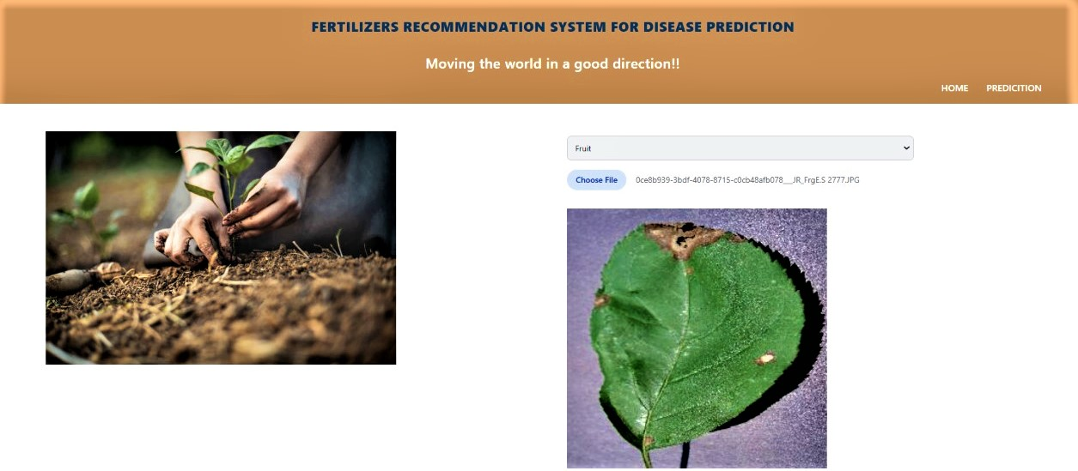
OUTPUT

Slide 9
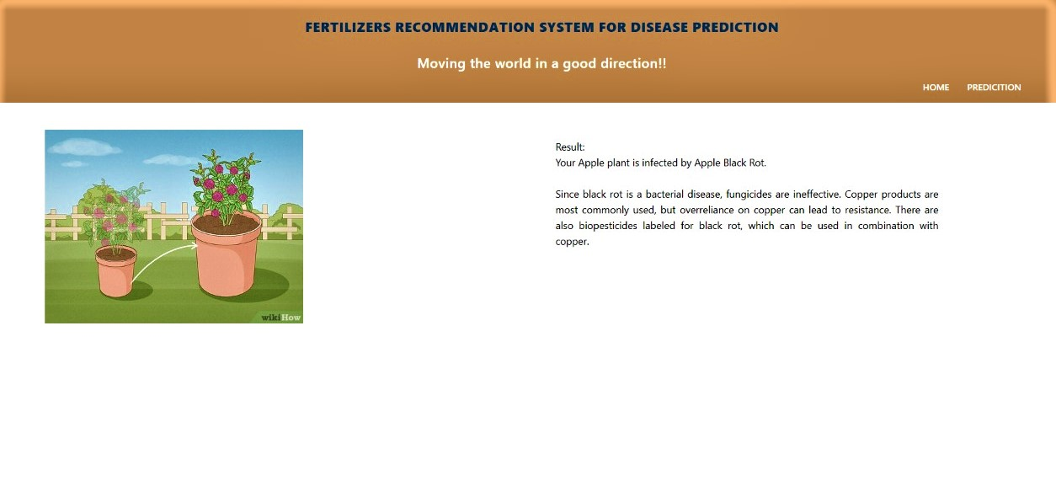
OUTPUT

Slide 10
APPLICATION
This web application can be used by farmers or users to check whether their plant is infected or not and can also show the remedy so that the user can take necessary precautions.
These kind of web applications can be used in the agricultural sector as well as for small house hold plants as well.

Slide 11

Thank you
Team Members:
SRIRAM SB [TL]
LOGESH SANJAY R
MANIKANDAN N
VENUGOPAL B

